Slide 1
Hand Gesture Recognition system
using mediapipe and opencv

Slide 2
Gesture recognition
Hand gesture recognition is a technique used to interpret and understand the movements of a person's hand and fingers, which can be used to control electronic devices or to communicate with computers. One powerful combination for developing hand gesture recognition systems is the use of the MediaPipe and OpenCV frameworks. MediaPipe provides pre-built, optimized pipelines for hand tracking, landmark detection and pose estimation, while OpenCV provides functions for image processing, object detection, and feature extraction. By combining the capabilities of MediaPipe and OpenCV, it is possible to build robust and accurate hand gesture recognition systems that can accurately interpret and understand the movements of a person's hand and fingers.

Slide 3
OPENCV
OpenCV (Open Source Computer Vision) is a library of programming functions that can be used to develop computer vision applications, including gesture recognition systems. OpenCV provides a wide range of tools and functions that can be used for image processing, object detection, and feature extraction, which are all essential components of a gesture recognition system.
Overall, OpenCV is a powerful tool that can be used to develop a wide range of computer vision applications, including gesture recognition systems, by providing a set of functions for image processing, object detection, and feature extraction, and machine learning capabilities.

Slide 4
Mediapipe
MediaPipe is an open-source framework developed by Google that can be used to develop computer vision applications, including hand gesture recognition systems. MediaPipe provides a set of pre-built, optimized pipelines for various computer vision tasks such as object detection, hand and landmark tracking, and pose estimation.
Overall, MediaPipe is a powerful tool that can be used to develop hand gesture recognition systems by providing pre-built, optimized pipelines for hand tracking, landmark detection, and pose estimation, as well as machine learning capabilities and support for multiple modalities input.

Slide 5
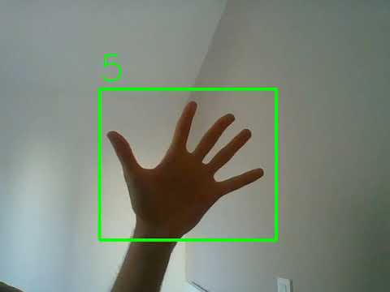
Palm Detection Model
To detect initial hand locations, Mediapipe framework designed a single-shot detector model optimized for mobile real-time.
Detecting hands is a decidedly complex task: our lite model and full model have to work across a variety of hand sizes with a large scale span (~20x) relative to the image frame and be able to detect occluded and self-occluded hands. Our method addresses the above challenges using different strategies. First, we train a palm detector instead of a hand detector, since estimating bounding boxes of rigid objects like palms and fists is significantly simpler than detecting hands with articulated fingers. In addition, as palms are smaller objects, the non-maximum suppression algorithm works well even for two-hand self-occlusion cases, like handshakes. Moreover, palms can be modelled using square bounding boxes (anchors in ML terminology) ignoring other aspect ratios, and therefore reducing the number of anchors by a factor of 3-5. Second, an encoder-decoder feature extractor is used for bigger scene context awareness even for small objects (similar to the RetinaNet approach). Lastly, we minimize the focal loss during training to support a large amount of anchors resulting from the high scale variance.

Slide 6
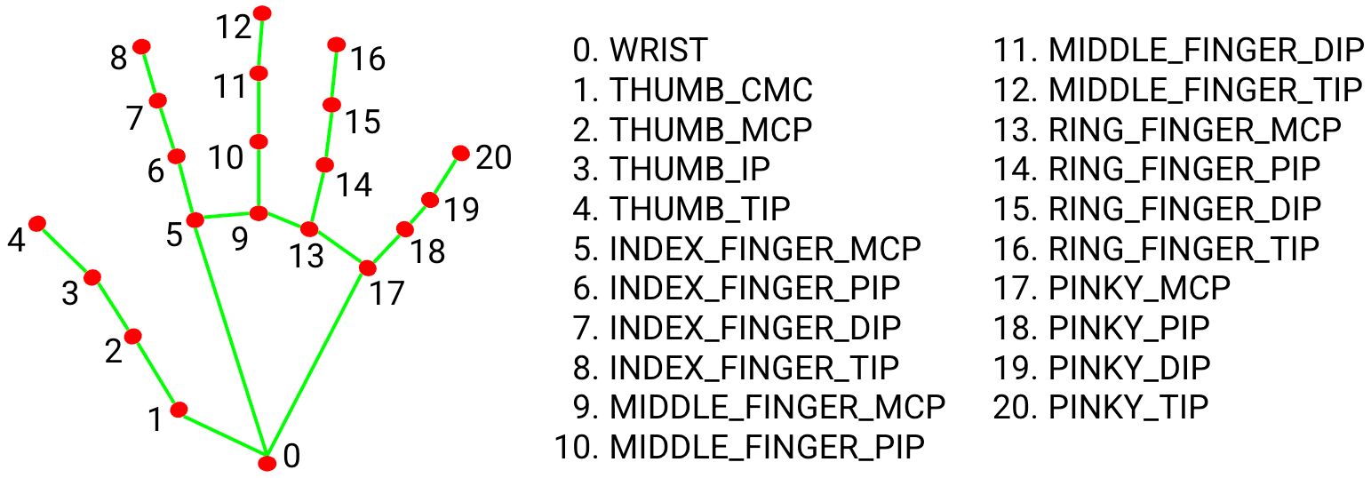
Hand Landmark model
After the palm detection over the whole image our subsequent hand landmark model performs precise keypoint localization of 21 3D hand-knuckle coordinates inside the detected hand regions via regression, that is direct coordinate prediction. The model learns a consistent internal hand pose representation and is robust even to partially visible hands and self-occlusions.
To obtain ground truth data, we have manually annotated ~30K real-world images with 21 3D coordinates, as shown below (we take Z-value from image depth map, if it exists per corresponding coordinate). To better cover the possible hand poses and provide additional supervision on the nature of hand geometry, we also render a high-quality synthetic hand model over various backgrounds and map it to the corresponding 3D coordinates.

Slide 7
THANK YOU
Devansh Rautela
Section – C
Rollno. – 20
Univ. Rollno. - 2018314

